Slide 1
EPE ‘25 conference 26th European Conference on Power Electronics and Applications Paris, France, March 31st > April 4th 2025
Paper Selection Meeting
Online
2 December 2024

Slide 2
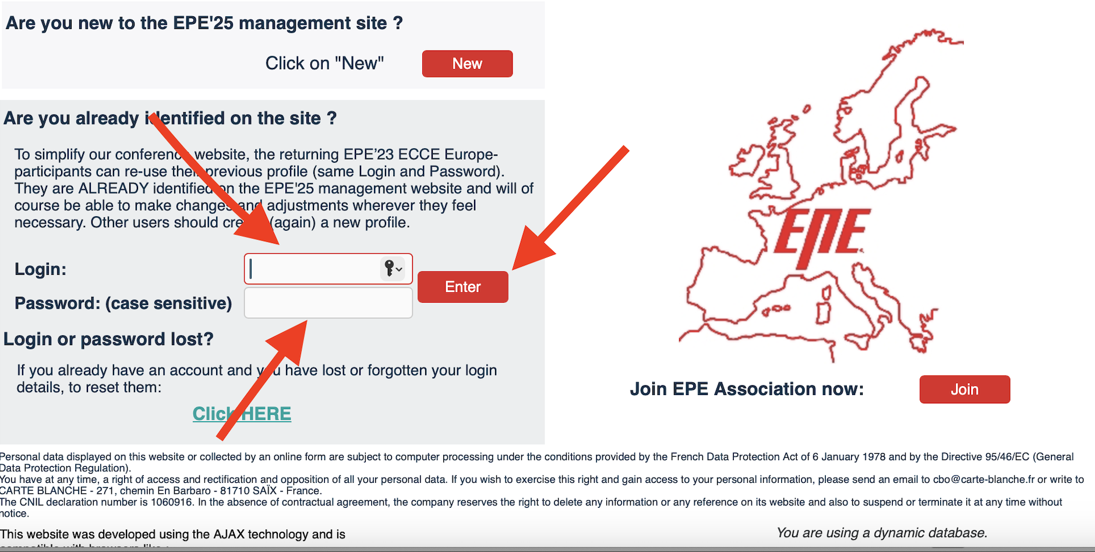
Step 1: Enter the host

Slide 3
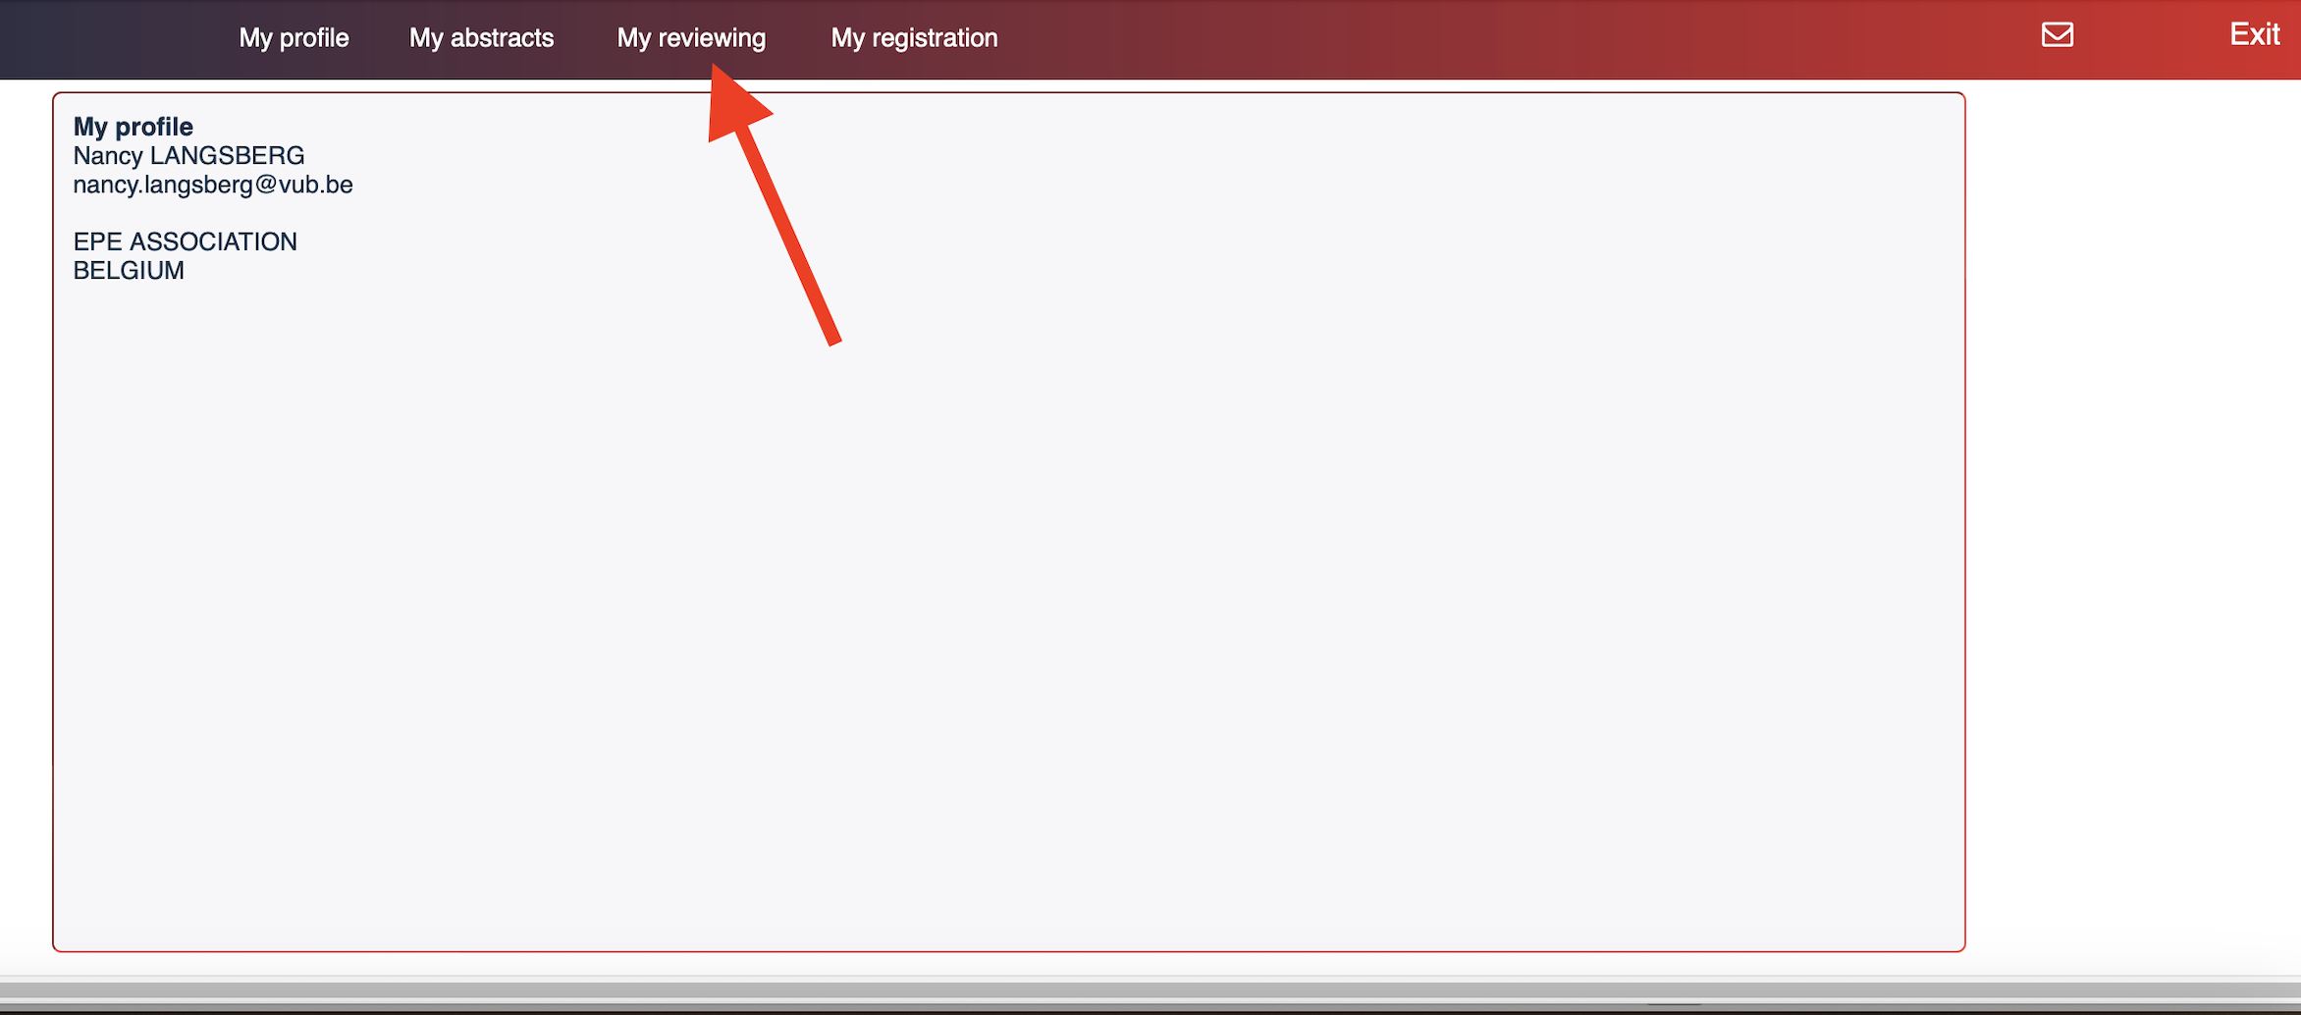
Step 2: Reviewing Proces

Slide 4
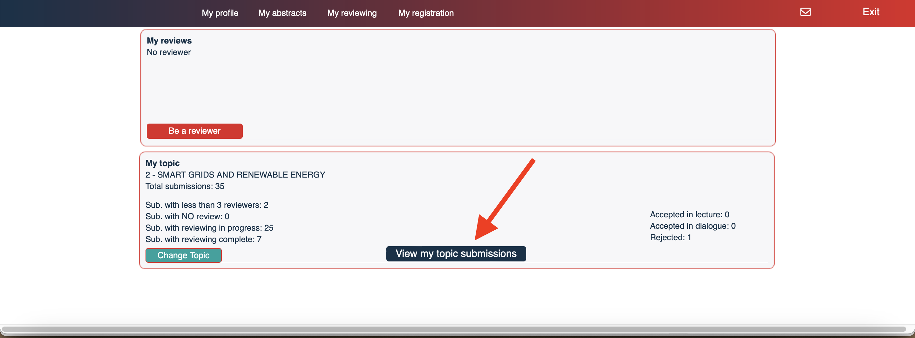

Slide 5
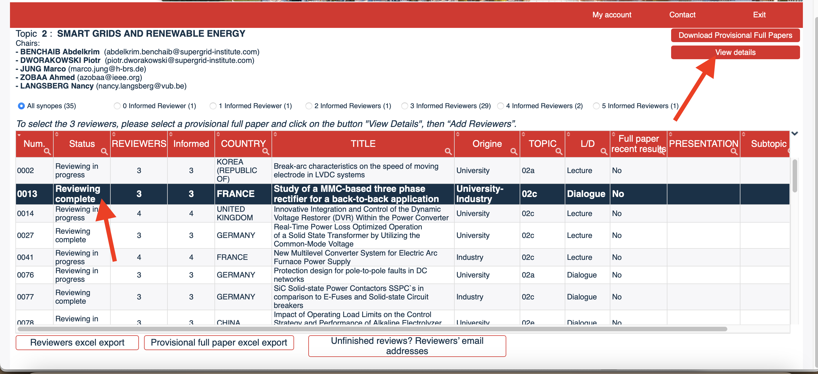

Slide 6
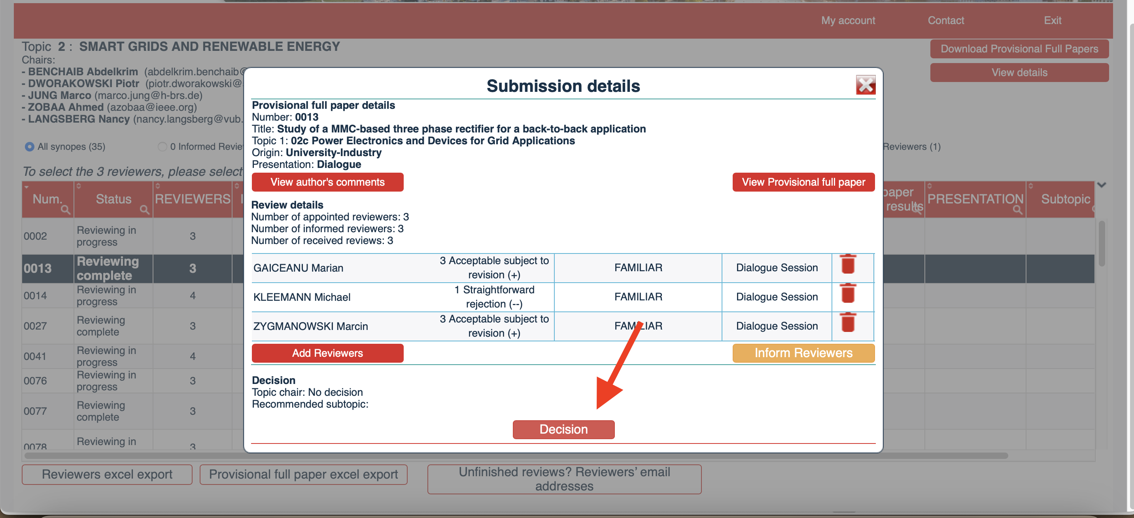

Slide 7
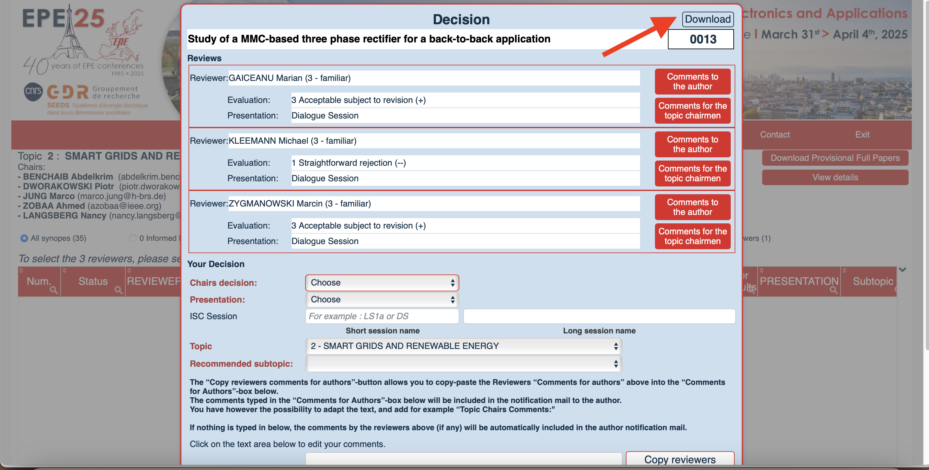
Step 5: Download Synopsis

Slide 8
Step 5: Download Synopsis
Read the provisional paper

Slide 9
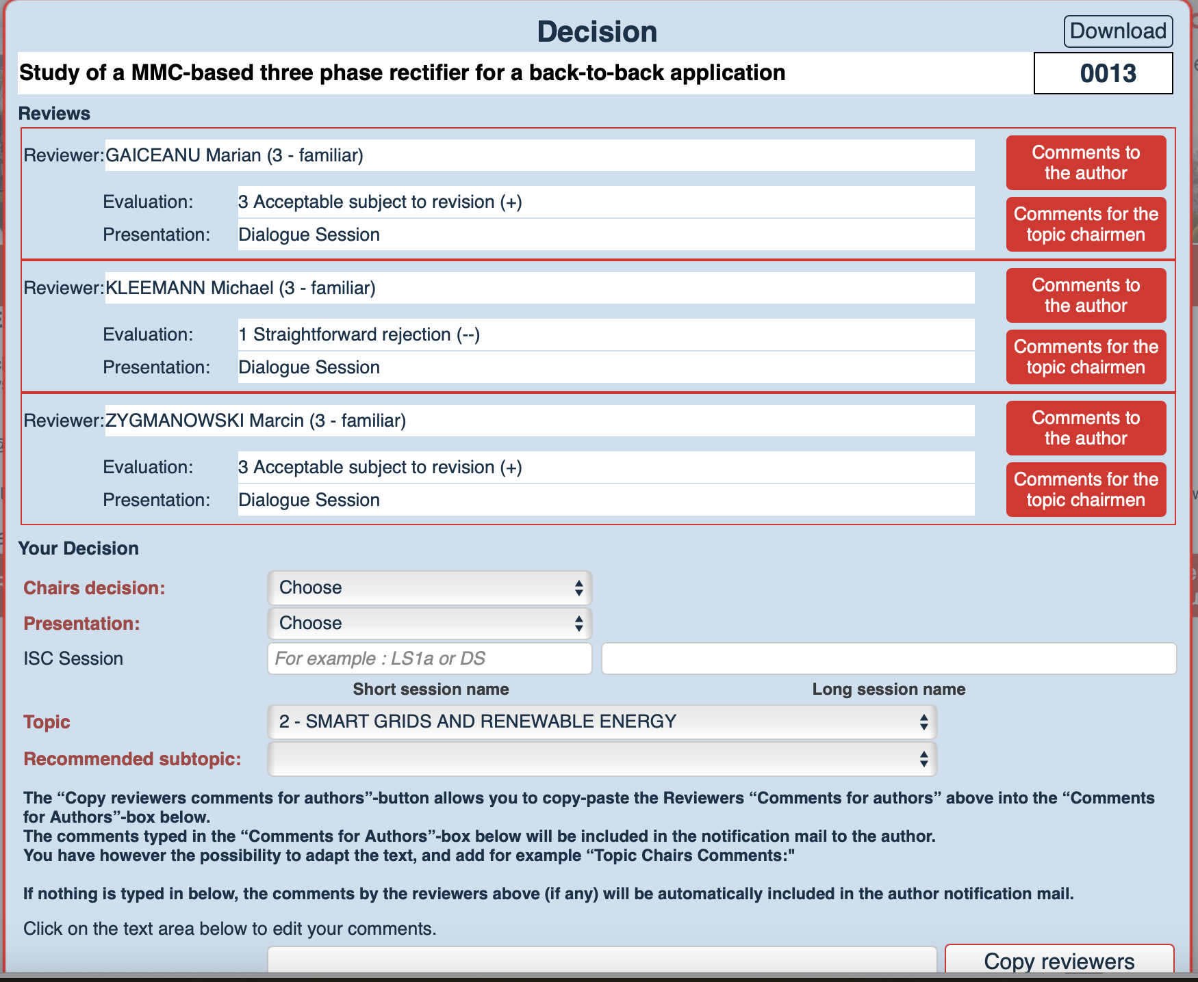
Scroll Down

Slide 10
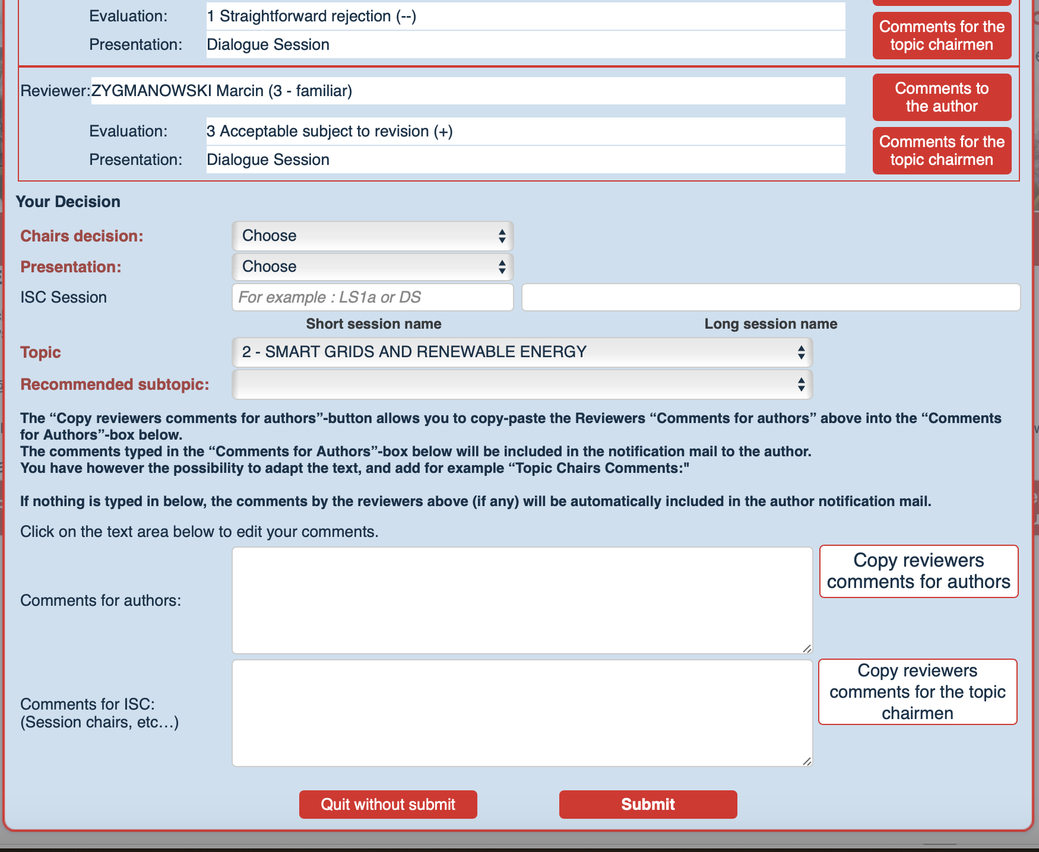

Slide 11
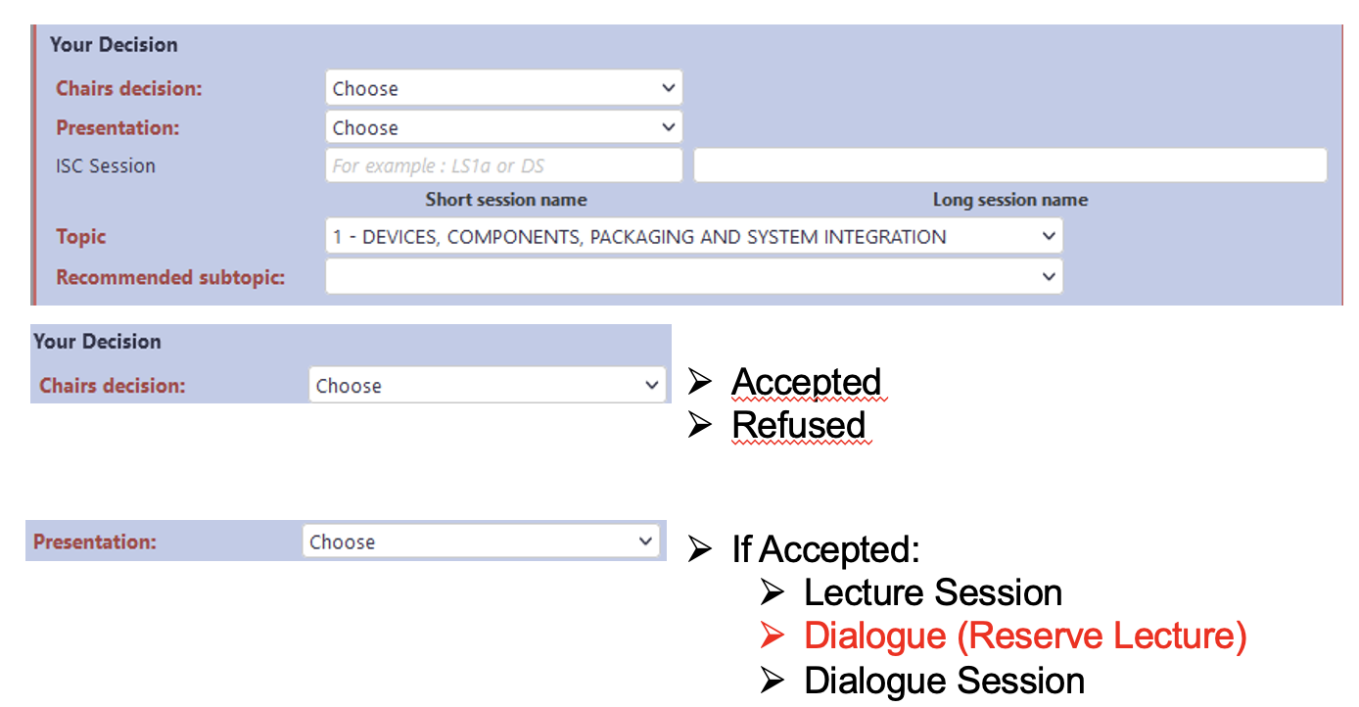

Slide 12
If accepted for Lecture or Dialoge (reserve Lecture), complete the Lecture Sessions

Slide 13
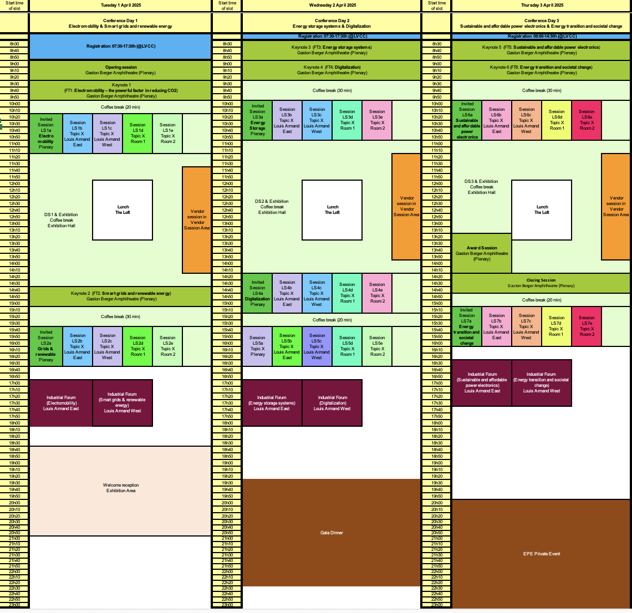
Notes:
----- Meeting Notes (04/02/20 09:51) -----
LS sessions move following topic of the day
DS also
OK for DC and e-mobility

Slide 14
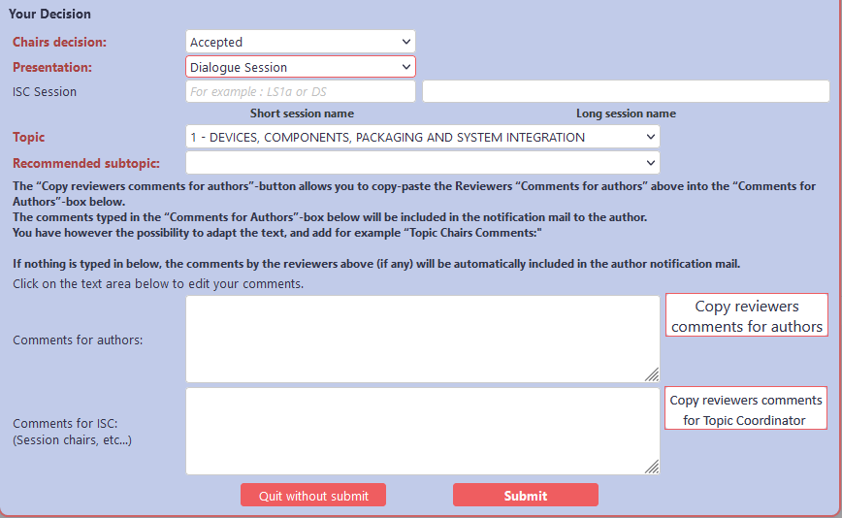
Topic 1 – DS
Passive Components

Slide 16
Comments to the author:
Comments to the Topic Coordinator:

Slide 17
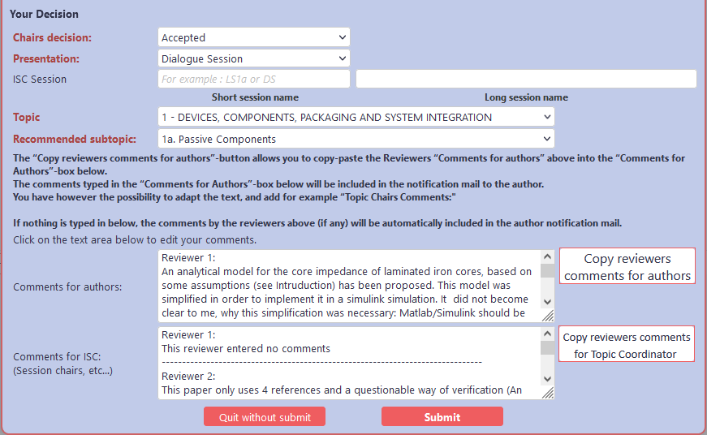

Slide 18
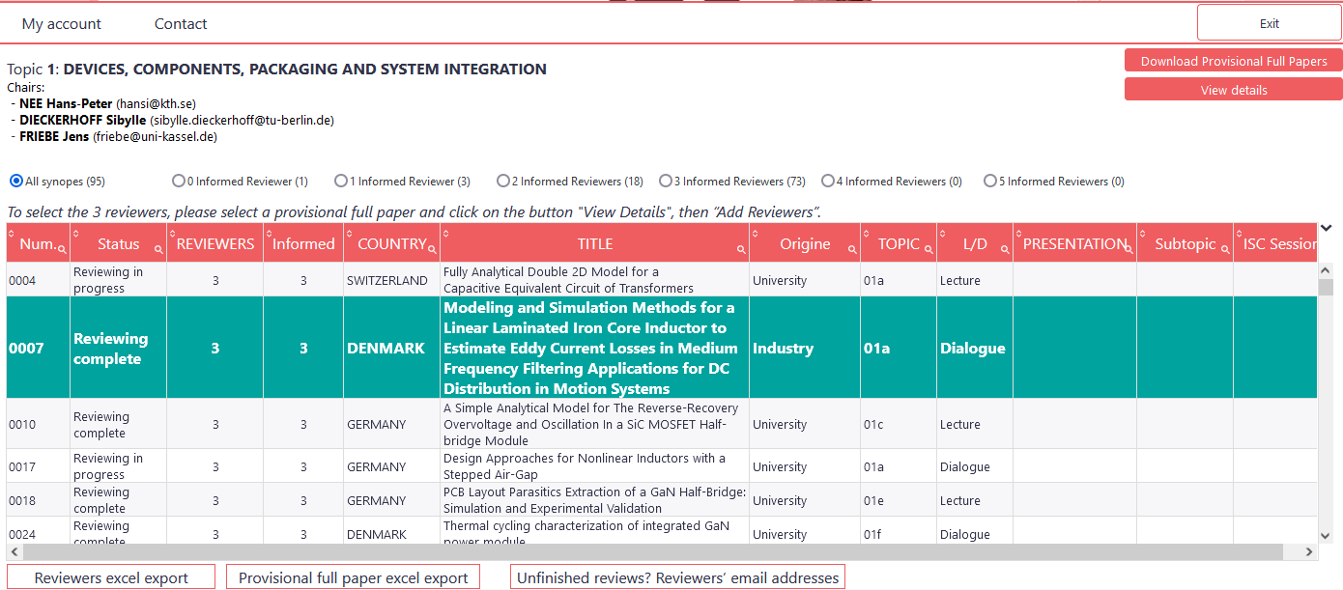

Slide 20
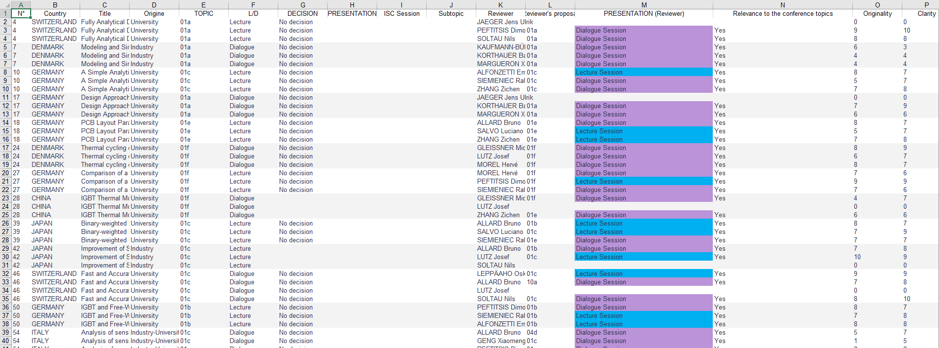

Slide 21
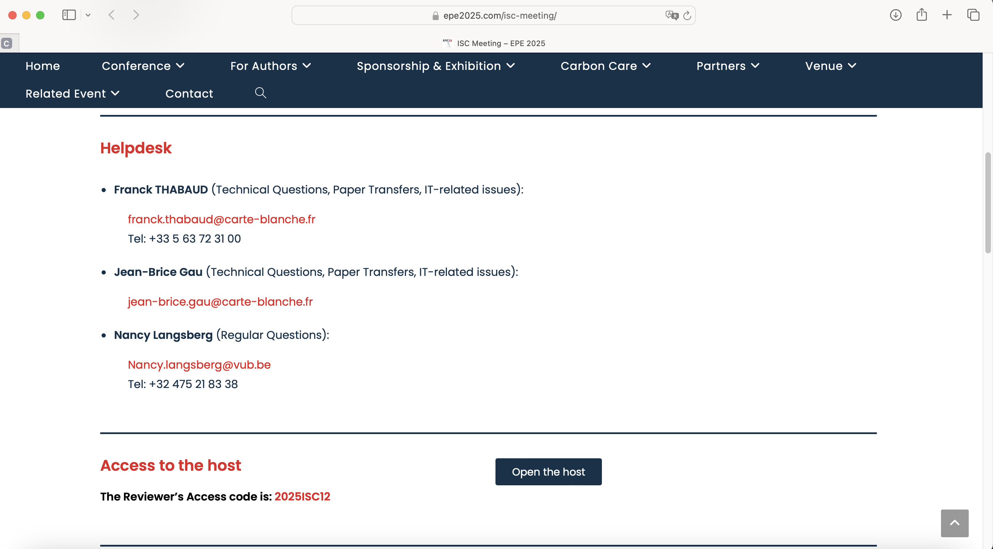

Slide 22
Questions?

Slide 23
Thank You !
Enjoy the Paper Selection Meeting & See you at the EPE’25 conference in Paris

