Slide 1

EPE ‘25 conference
26th European Conference on Power Electronics and Applications
Paris, France – March 31st > April 4th 2025
Meeting of the
International Scientific Committee
- Online -
2 December 2024

Slide 2
Apologies
Alain Bouscayrol
Jens Friebe
Philippe Lataire
Stephane Lefebvre
Andreas Lindemann
Salvatore Musumeci
Daniel Montesinos
Yves Perriard
Xavier Roboam
Joeri Van Mierlo
..
Notes:
----- Meeting Notes (04/02/20 09:51) -----
matthias hofer
Frediric De Belie
Pablo Briff

Slide 3


We are on Social Media!
Join us and spread the news

Slide 4
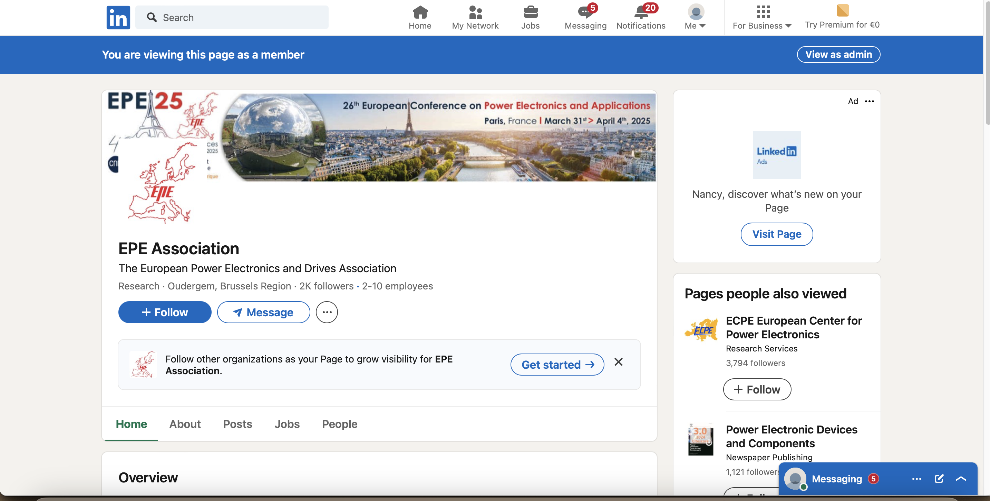
LinkedIn

Slide 5
Agenda
1. Apologies
2. EPE’25 statistics
3. Status of the Provisional Programme of EPE ECCE Europe 2023
  - Focus Topics
  - Tutorials
  - Keynotes, Special Sessions, Invited Lectures
  - Afternoon Panel Discussion Sessions
  - Etc…
4. Any other business
Notes:
----- Meeting Notes (04/02/20 09:51) -----
matthias hofer
Frediric De Belie
Pablo Briff

Slide 6
Number of Provisional Full Papers
 | EPE’23 ECCE Europe Aalborg, Denmark (Prov. Full Paper Phase) | EPE’25 conference Paris, France (Prov. Full paper phase) | Difference
Number of Uploads: | 589 | 331 | -258
Number of Withdrawals: | 22 | 33 | +11
Number of Provisional Full Papers: | 567 | 298 | -269

Slide 7
Number of Synopses & Provisional Full Papers
 | Geneva 2015 | Karlsruhe 2016 | Warsaw 2017 | Riga 2018 | Genova 2019 | Lyon 2020 | Ghent 2021 | Hannover 2022 | Aalborg 2023 | Paris 2025
Uploads: | 833 | 666 | 718 | 504 | 687 | 648 | 461 | 568 | 589 | 331
Withdrawn: | 27 | 10 | 19 | 14 | 43 | 19 | 12 | 22 | 22 | 33
Synopses: | 806 | 656 | 699 | 490 | 644 | 629 | 449 | 546 | 567 | 298

Slide 8
Number of Synopses
Number of Synopses & Provisional Full Papers

Slide 9
Per Topic: Comparison 2023 ⬄ 2025
Synopses per topic: |  | EPE 2023 | EPE 2025
Topic 1 | Electromobility | 44 | 31
Topic 2 | Smart Grids and Renewable Energy | 98 | 35
Topic 3 | Energy Storage Systems |  | 37
Topic 4 | Digitalization |  | 8
Topic 5 | Sustainable and Affordable Power Electronics |  | 13
Topic 6 | Energy Transition and Societal Change |  | 1
Topic 7 | Semiconductor Devices and Packaging | 95 | 24
Topic 8 | Components linked to Power Electronics |  | 20
Topic 9 | Power Converter Topologies | 100 | 60
Topic 10 | Converter Modelling, Design and Low-level Control | 60 | 18
Topic 11 | Measurement, Supervision and Control for Power Converters | 58 | 20
Topic 12 | Electrical Machines and Drive Systems | 53 | 23
Topic 13 | Power Supplies and Industry-specific Power Electronics | 23 | 10
 | T10 & 11 EPE 2023 | 36
 | TOTAL | 567 | 300

Slide 11
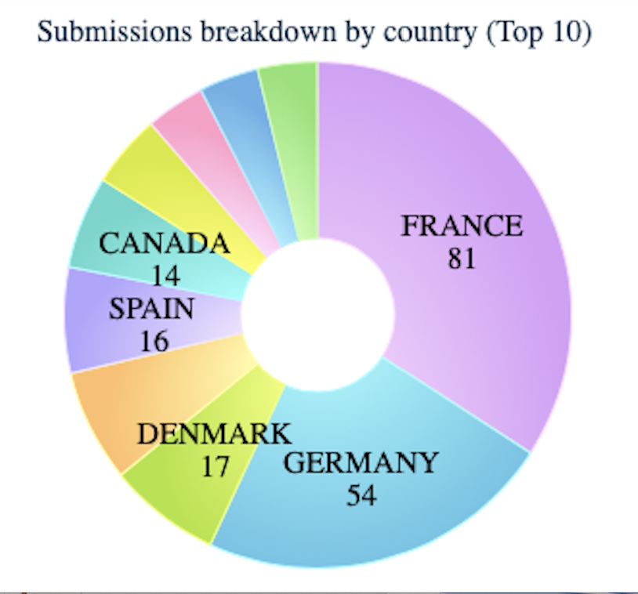
Uploads per Country

Slide 12
Synopses & Prov. Full Papers per Organizing Country
 | Organizing Country | Total Number | In %
EPE 2014 ECCE – Finland | 65 | 560 | 12%
EPE 2015 ECCE – Switzerland | 53 | 806 | 7%
EPE 2016 ECCE – Germany | 188 | 656 | 29%
EPE 2017 ECCE – Poland | 80 | 699 | 11%
EPE 2018 ECCE (A) – Latvia | 25 | 490 | 5%
EPE 2018 ECCE (B) – Baltics + Scandinavia | 105 | 490 | 21%
EPE 2019 ECCE – Italy | 52 | 644 | 8%
EPE 2020 ECCE – France | 100 | 629 | 16%
EPE 2021 ECCE – Benelux + RWTH | 39 | 448 | 9%
EPE 2022 ECCE – Germany | (182) 214 | (437) 546 | 39%
EPE 2023 ECCE – Denmark | 53 | 567 | 9%
EPE'25 - France | 81 | 298 | 27%

Slide 13
Received Tutorial Proposals
 | title
TUT 01 | Fundamentals to Understand Parasitic Capacitances in Magnetic Components
TUT 02 | Design, Validation, and Embedded Deployment of AI-Based Virtual Sensor for Battery State-of-Charge (SOC) Estimation
TUT 03 | Methods to Identify & Control Highly Non-Linear Three-Phase Machines
TUT 04 | EV Charging Technologies: Power Electronics and Quality
TUT 05 | DC Transformers for DC Distribution and Transmission
TUT 06 | Multi-objective and highly precise optimization of high performance SiC and GaN multilevel power inverters with severe constraints
TUT 07 | System Level Modelling and Simulation of MVDC Distribution Grids featuring Solid State Transformers
TUT 08 | Model Predicetive Control of Power Converters and Drives
TUT 09 | Industrial medium-voltage converters and drives: from components to systems and applications
TUT 10 | Power Quality and Operability of Distributed Power Generation Systems: Advanced and Intelligent Control
TUT 11 | Power Converters for Electrolyser Systems: State-of-the-Art and Prospects
TUT 12 | Typhoon HIL Integrated Simulation Environment: Streamlining the Development Cycle from Offline to Real-Time HIL Simulation
TUT 13 | Characterising GaN HEMTs & SiC MOSFETs – Device Characteristics and Characterisation
Notes:
----- Meeting Notes (04/02/20 09:51) -----
out: T3,T1, T6, T9 (out of topic)

Slide 14
Tutorials
The received tutorial proposals have been sent to the ISC members for reviewing.
Results are collected and will be sent to ISC chairman.
The local team will try to receive some extra proposals (responsible: Betty Semail)
Deadline: 16 December 2024

Slide 15
Status of preparation of technical programme
Information from the Local Organising Committee‘25

Slide 16
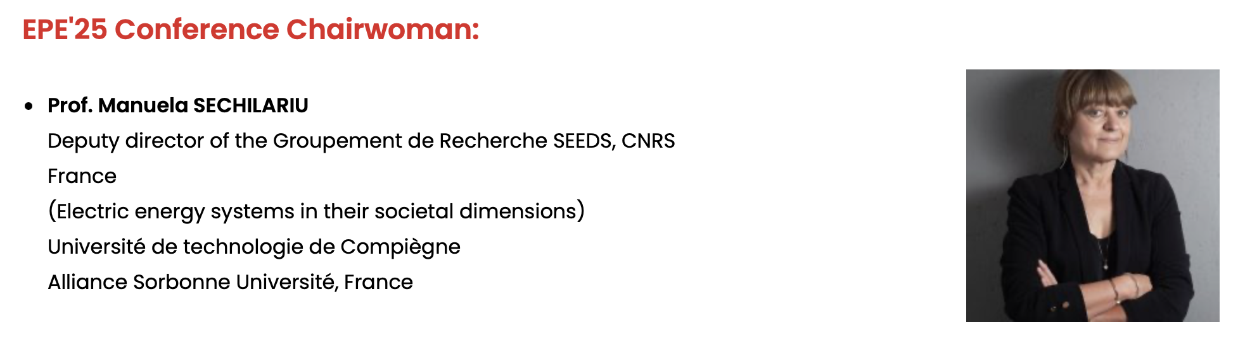
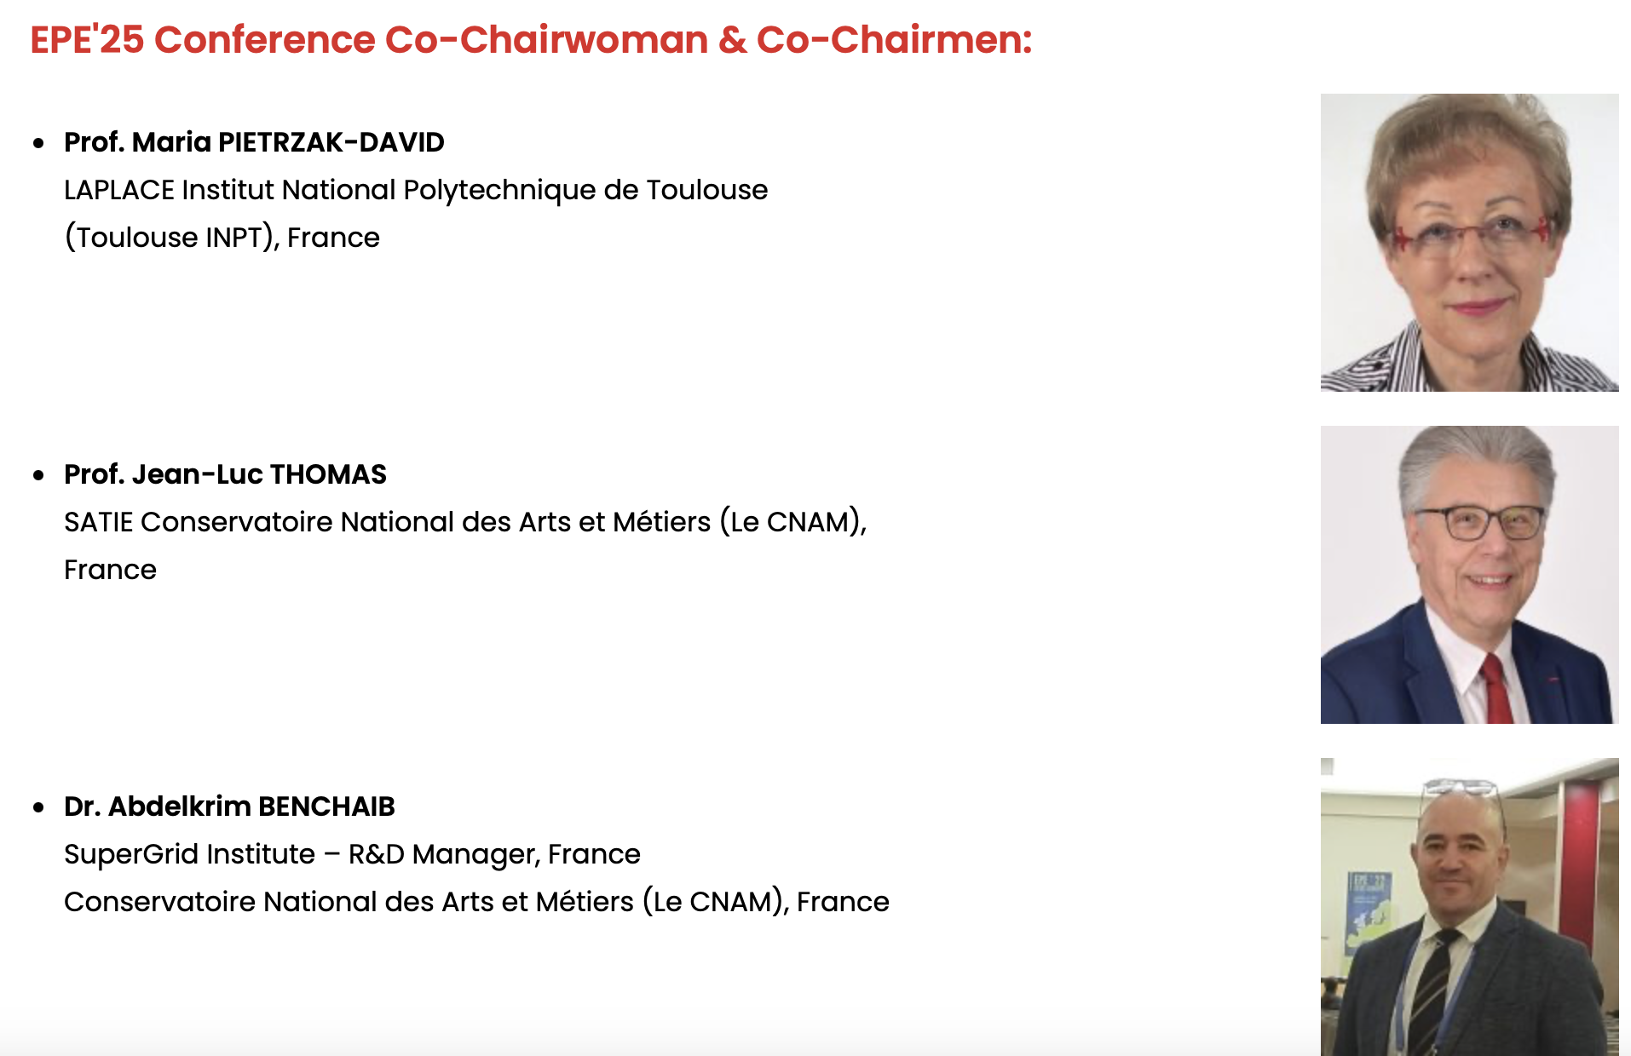
Conference chairs & organizing committee

Slide 17
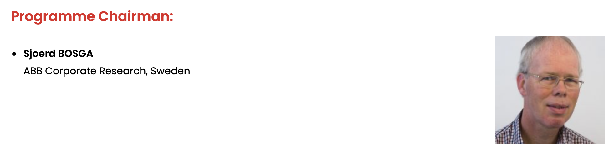
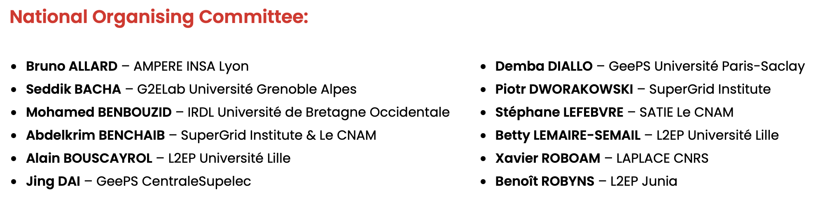
Conference chairs & organizing committee

Slide 18
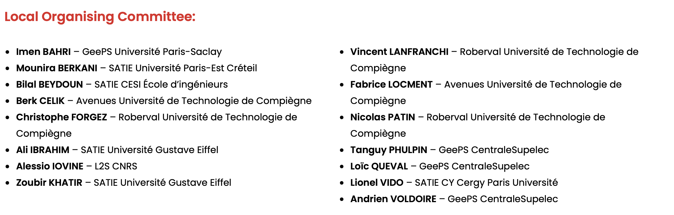
Conference chairs & organizing committee

Slide 19
Focus Topics
Tuesday 1 April:
1. Electromobility – The Powerful Factor In Reducing C02
2. Smart Grids And Renewable Energy
Wednesday 2 April:
3. Energy Storage Systems
4. Digitalization: The Powerful Fusion Of AI And IoT For Sustainability
Thursday 3 April:
5. Sustainable And Affordable Power Electronics
6. Energy Transition And Societal Change

Slide 20
Focus Topics
Each of the Focus Topics will be covered by the following key formats:
1 Keynote Presentation
1 Panel Discussion (= Industrial Forum)
Eventually sessions can be completed with invited papers (will be decided after the paper selection meeting)
Optional additional formats are:
Tutorials
Technical Visits

Slide 21
Status of the Focus Topics
Keynotes
1 Keynote for each of the Focus Topics (titles preliminary):
FT1 - Electromobility – The Powerful Factor In Reducing C02 :
Florent Nierlich and/or Thierry LEBEY - Safran: Electrical system trends for future aerospace platforms
FT2 - Smart Grids And Renewable Energy : Colin Davidson, GE Vernova, UK
FT3 - Energy Storage Systems : not confirmed yet
FT4 - Digitalization: The Powerful Fusion Of AI And IoT For Sustainability : not confirmed yet
FT5 - Sustainable And Affordable Power Electronics : not confirmed yet
FT6 - Energy Transition And Societal Change : Anouk BARBEROUSSE, directrice ITE Sorbonne Université

Slide 22
Technical visits - provisional
Technical visits
RTE Paris Electrical System Operations Center (COSE-P)
Synchrotron CEA
IFPEN Laboratory
Technical Center of EDF
Possible 2 cultural visits

Slide 23
Recent results
opportunity for rapid publication of emerging work by industry and academia
submissions of full paper in all focus topics and main topics relevant to EPE’25
Deadline: 31st December 2024
All submissions should emphasize the novelty of the work and the results obtained
Notification date to authors: 15 January 2025
Responsible: Alain Bouscayrol

Slide 24
Best papers
The best provisional full papers will be selected to be published in a special Elsevier issue
Papers will be selected based on the reviewer’s evaluation
Authors will receive a separate notification if they are selected.

Slide 25


Slide 26
Paper Selection Meeting
After this meeting there will be different zoom channels, one per topic
Just click on the link of the group you want to work in.
The next presentation will show you how to proceed

Slide 27
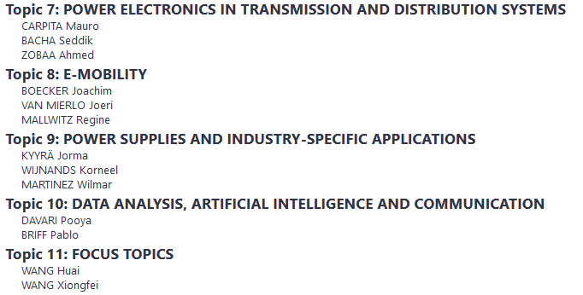
Tomorrow’s Paper Selection Meeting
What is the situation?
How do you plan to proceed?

Slide 28
Any Other Business
?

Slide 29
Next meeting of the ISC
?

Slide 30
Thank You !
Enjoy the Paper Selection Meeting

